Slide 1


BRITISH AIRWAYS
Customer Review Analysis and Insights

Slide 2
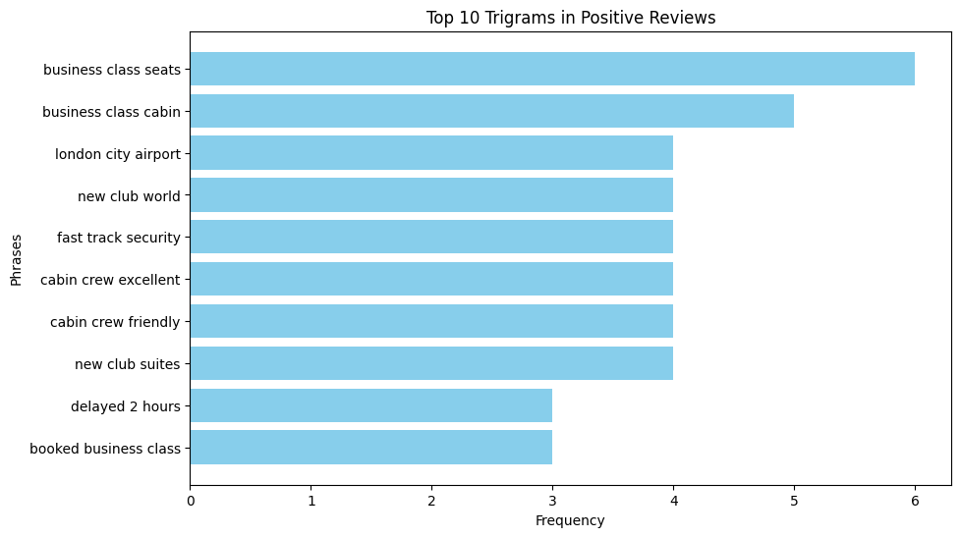
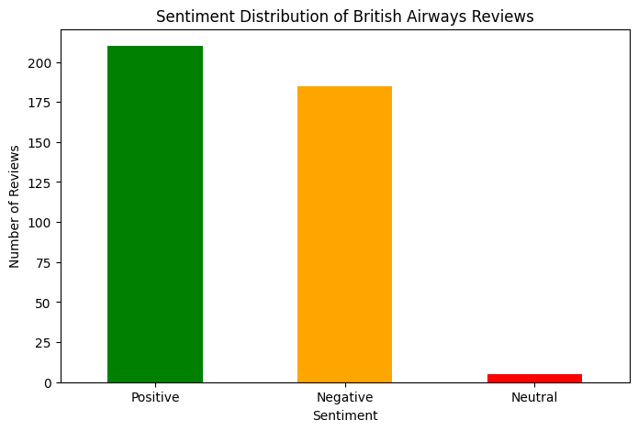
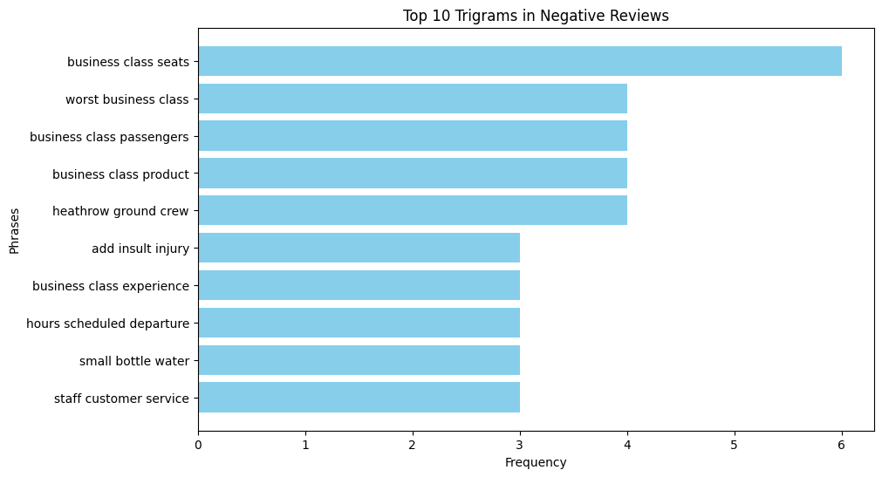
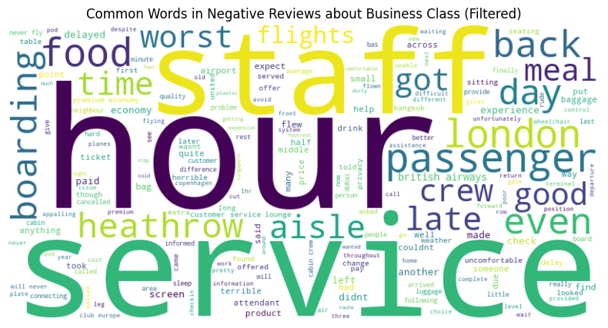
Key Findings
Average Overall Rating
3.44/10
Over 400 Reviews from the last Year
Focus On: To improve the customer experience, British airways should focus on improving business class experience by doing little things like upgrading inflight entertainment. They should also improve cabin crew services and providing better food and beverages. They should also address delays and lost luggage more efficiently along with improving seat comfort would help with the overall customer experience
However, customers seem to be happy with the friendliness of the cabin crew in the business class as well as the fast-track security and the most positive reviews came from the London city airport
What customers are happy and angry about based off review ratings
7-10 Ratings - mainly talked about good service, comfortable seats and a friendly crew
4-6 Ratings – this is a mix of both positive and negative reviews and for these they mainly talked about seats, staff and food. There are mentions of good but also reference to poor service
1-3 Ratings – the main complaints seemed to revolve around luggage, time delays, cabin crew and overall poor experience with check-in, boarding and delays

